Slide 1
Cloud Computing
Presented By : Medhavi College

Slide 2
Cloud
Refers to a Network or Internet
Present at remove location
Provide services over network i.e on public or private networks i.e. WAN, LAN or VPN

Slide 3
Cloud Computing
Refers to manipulating, configuring and accessing the applications online
Offers online data storage, infrastructure and application
Combination of software and hardware based computing resources delivered as a network service
Principle : Pay as you Use
Customers do not own the physical infrastructure
Working models for cloud computing
Deployment Models
Service Models

Slide 4
Deployment Models
Defines the type of access to the cloud i.e how the cloud is located ?
Types
Public - Allows system and services to be easily accessible to the general public. May be less secure, e.g. AWS, Microsoft Azure, Sun Cloud etc
Private - Allows systems and services to be accessible within an organization. More security. Eg : AWS, VMware
Hybrid - Mixture of public and private cloud. Critical activities are performed using private cloud and non-critical using public cloud. Eg : government departments may use such kind
Community - Allows systems and services to be accessible by group of organizations

Slide 5
Service Models
Reference models on which the Cloud Computing is based.
Categorized into three basic service models
Infrastructure as a Service (IaaS)
Platform as a Service (PaaS)
Software as a Service (SaaS)

Slide 6
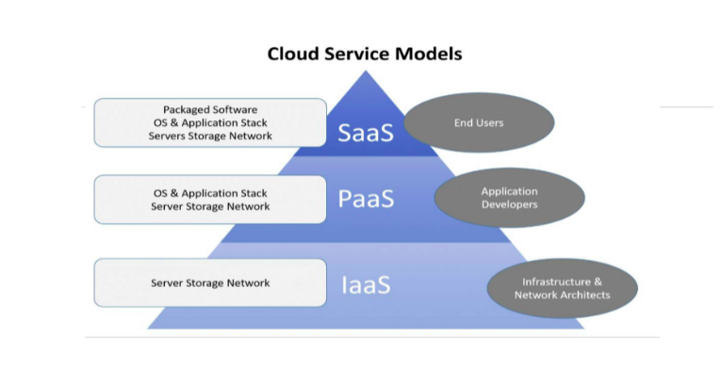

Slide 7
Infrastructure as a Service (IaaS)
Delivery of technology infrastructure as an on demand scalable service
Provides access to fundamental resources such as physical machines, virtual machines, virtual storage, networking components etc
Can be coupled with Managed Services for OS and application support
In real meaning, you can rent someone else’s hardware by the minute, hour or monthly used basis
IaaS providers include AWS, Microsoft Azure and Google Compute Engine
Users : IT Administrators
Eg : AWS-EC2, Microsoft Azure, GOGRID

Slide 8
Platform as a Service (PaaS)
Cloud environment in which clients can develop, manage, and deliver applications.
Provides all the facilities required to support the complete life cycle of building and delivering web applications and services entirely from the internet
Allows organization to focus on development and not concern about infrastructure
Users : Software Developers

Slide 9
Software as a Service (SaaS)
Allows to use software applications as a service to end users
Software delivery methodology that provides licensed multi-tenant access to software and its functions remotely as a Web Service
Usually billed based on usage
Usually multi tenant environment
Highly scalable architecture
Users : Public Users/ Organizations

Slide 10
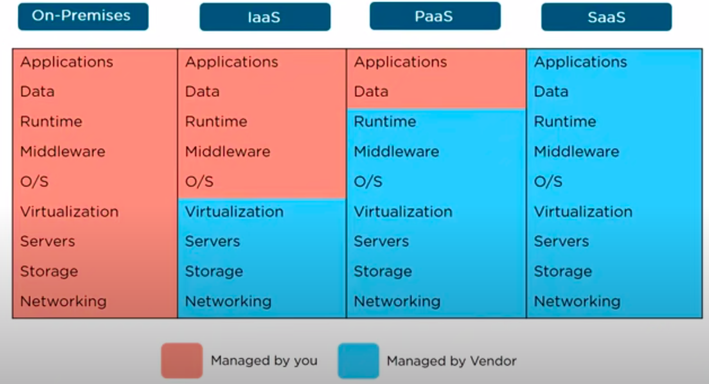

Slide 11
Advantages
Lower computer costs
Improved performance
Reduces software costs
Instant software updates
Unlimited storage capacity
Increased data reliability
Device independence
Latest version availability

Slide 12
Disadvantages
Requires a constant internet connection
Doesn't not work well with low-speed connections
Features might be limited
Can be slow
Stored data can be lost
Stored data might not be secure

